Slide 1
Contact List Management
Simple python Gui based project

Slide 2
Introduction
This project is aimed to create a interface that helps in storing the list of contact and managing it accordingly.
In this admin is available to add up the new contact , deleting them, search by the name, view them, update them accordingly.
Only admin have permission to perform all these activities else you can view the contact list only.
Simple and effective gui created by Tkinter library
Database connectivity done by sqlite.

Slide 3
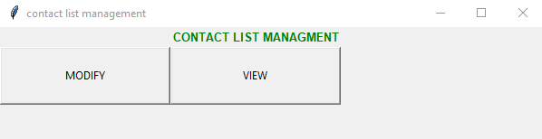
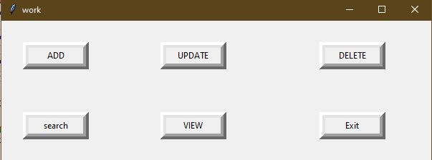
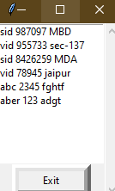
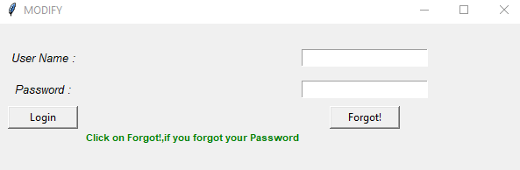
Output
This button allow you to modify contact list after login
It display the list.
After login this will appear

Slide 4
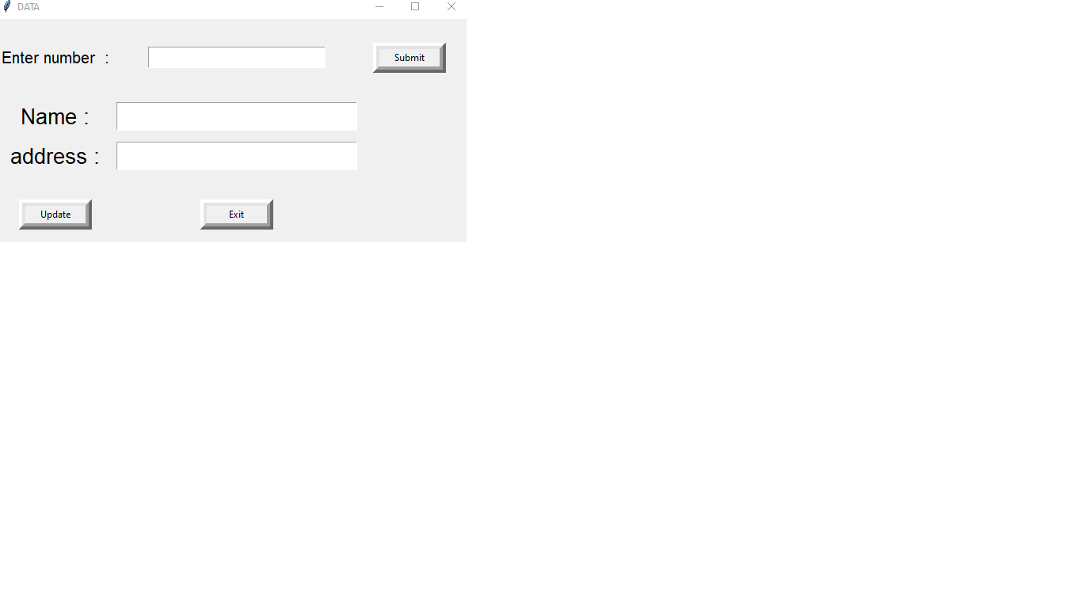
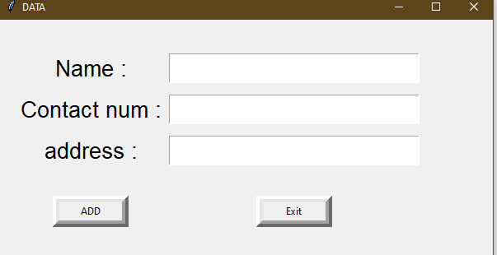
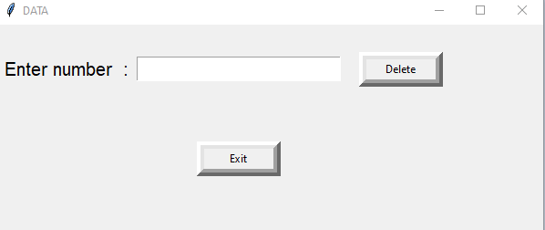
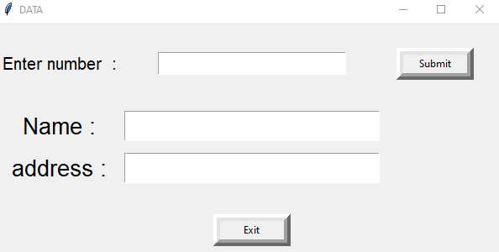
Admin Functionality

